Slide 1
Celebrity Voice Match: Identifying and Comparing Voices with Celebrity Voices Dataset
Giulia Rivetti (s4026543), Yağmur Doğan (s3910024), Evan Meltz (s3817911), Kacper Kadziolka (s4115945)
Cyberpunk 2024
project

Slide 2
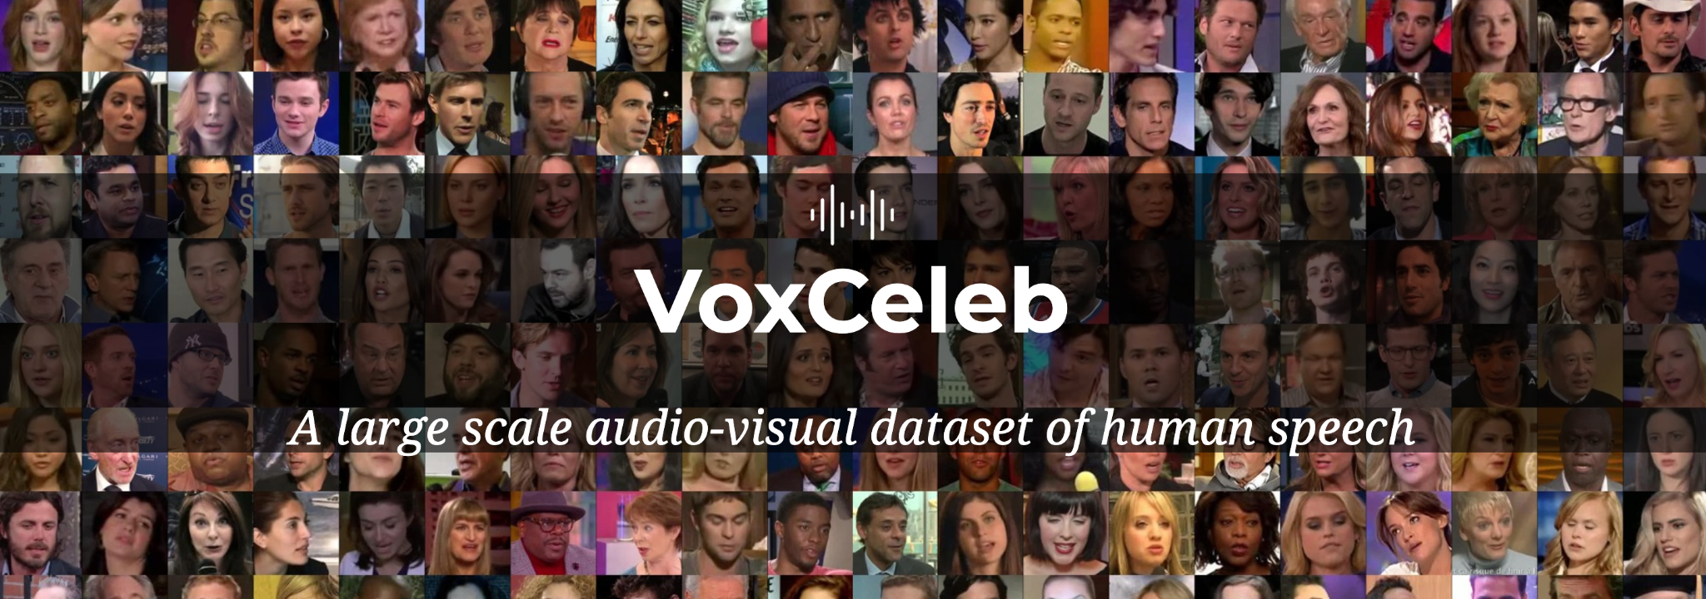
Problem Description
Process the voice of celebrities from a dataset
Dataset: VoxCeleb / MavCeleb
Match the voice to the correct celebrity
Match a test sample audio to the most similar celebrity’s voice

Slide 3
Challenges and Novelty
Novelty: finding the celebrity whose voice is most similar to a given test sample, which
will comprise our voices.
Challenges:
Properly matching people’s voices to celebrities from dataset
Noise in dataset (data drift - using different microphones)
Deciding which features would be more important for our task
Handling shorter audios
Unbalanced distribution of dataset (40% of celebrities are from U.S.A)

Slide 4
Goals for the Demo Day
System consisting of:
Data pre-processing pipeline
Fine-tune model
Voice matching algorithm from microphone input
Resulted in selected celebrity with most similar voice

Slide 5
Division of work
Equal division of work between the 4 of us among all the tasks.

Slide 6
Thanks for your attention

